Slide 1




Introduction To DevSecOps
David Okeyode - Cloud Security Architect at Sophos PLC
3xMCSE | MCT | VCP | CCNP | AWS SA-Pro
BLOG: https://azurehangout.com
@asegunlolu asegunlolu
Notes:
Thanks very much for the introduction John and thanks for the opportunity to speak to this group of intellectuals, DevOps and security professionals today. Hello everyone, thank you for being here. My name is David Okeyode and I’m a cloud security architect at Sophos. For those that may not know, Sophos is an IT security company based in Abingdon, Oxfordshire. We’ve been around for over 30 years and we’re a global leader in CyberSecurity including areas like endpoint security, network security and cloud security that I’ll be talking to you about today.

Slide 2


Mental Health Awareness Week Coming!
Notes:
First I’ll like to highlight that

Slide 3
Agenda
The Changes In The World
The Issues – Security
The Issues - DevOps
What is DevSecOps?
DevSecOps components
Key takeaways
DevSecOps Resources
Notes:
Waterfall
Weeks long development followed by weeks long testing followed by weeks long user testing doesnt work
Customers expect quick releases
Can hurt competitively
Agile
Agile comes in to fit some of the gaps
Agile works to speed up the delivery of applications
Agile solves the problem of multiple releases
Typical agile projects are organized in 1 to 2 weeks sprint
Agile allows product owners to define sprint backlogs and development teams to prioritize work
Dev teams can re-arrange tasks based on bottlenecks or priority
Agile solves a lot of problems that we had with waterfall but it didn't solve all the issues
There's more to software delivery than software development.. we have to deal with the environment that the software will run - building servers, networking (operations)
Software delivery (Development, Testing, Operations)
Agile solves the dev and testing issues but not the operations
DevOps as "a set of practices intended to reduce the time between committing a change to a system and the change being placed into normal production, while ensuring high quality
DevOps is a combination of practices or processes, tools and technology to increases an organization's ability to deliver applications and services at high velocity: evolving and improving products at a faster pace than organizations using traditional software development and infrastructure management processes.

Slide 4
The Changes In
The World
Notes:
The issues with where we are

Slide 5
3 Major Movements
Waterfall → Agile → DevOps
Monolith → Microservices
Datacenter → Cloud
Notes:
Waterfall
Weeks long development followed by weeks long testing followed by weeks long user testing doesnt work
Customers expect quick releases
Can hurt competitively
Agile
Agile comes in to fit some of the gaps
Agile works to speed up the delivery of applications
Agile solves the problem of multiple releases
Typical agile projects are organized in 1 to 2 weeks sprint
Agile allows product owners to define sprint backlogs and development teams to prioritize work
Dev teams can re-arrange tasks based on bottlenecks or priority
Agile solves a lot of problems that we had with waterfall but it didn't solve all the issues
There's more to software delivery than software development.. we have to deal with the environment that the software will run - building servers, networking (operations)
Software delivery (Development, Testing, Operations)
Agile solves the dev and testing issues but not the operations
DevOps is about speeding up the software delivery process
Agile is a development methodology. DevOps is a culture shift.. devops is a way of approach to overall application lifecycle
The whole process moves very fast
DevOps is a large culture change. Not only for developers but for an organization

Slide 6
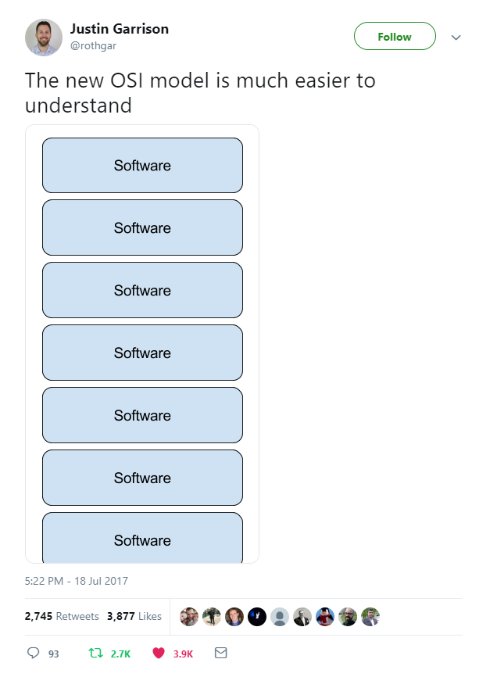
Software-Defined Everything

Slide 7
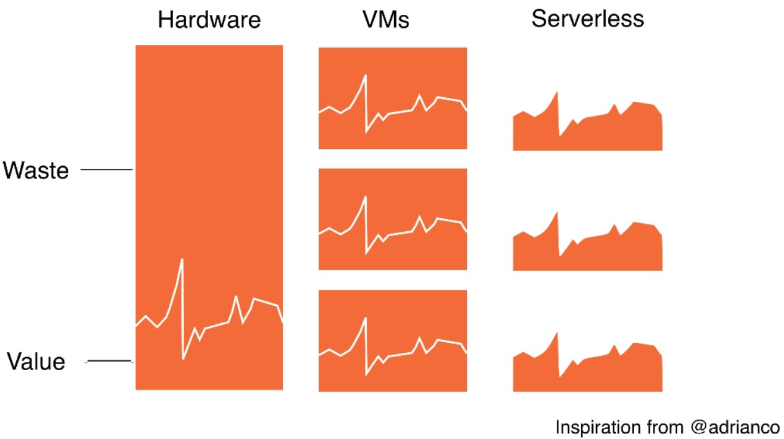

Slide 8
The Issues –
Security
Notes:
The issues with where we are

Slide 9

The Issues (Security) – We live in a DevOps world
”Many Security teams work with a worldview where their goal is to inhibit change as much as possible”
Notes:
The issues – Security
We live in a DevOps world
For some reason, many security teams have missed this memo. Either they’ve missed the memo or don’t fully appreciate the impact of the DevOps culture shift. I personally think it’s a combination of both but whatever the case, the consequences are dangerous!
They still live in a world of trying to control change and writing guidance documents with the hope that the rest of the organization follows their well written documents
I think the quote on the screen captures this well – “Many Security teams work with a worldview where their goal is to inhibit change as much as possible”
The issue with that is that this world is speedily going away and will soon no longer exist!

Slide 10
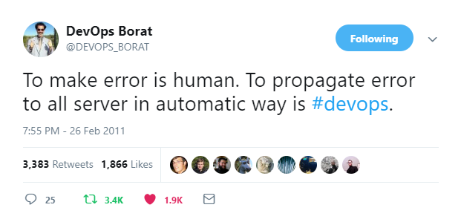
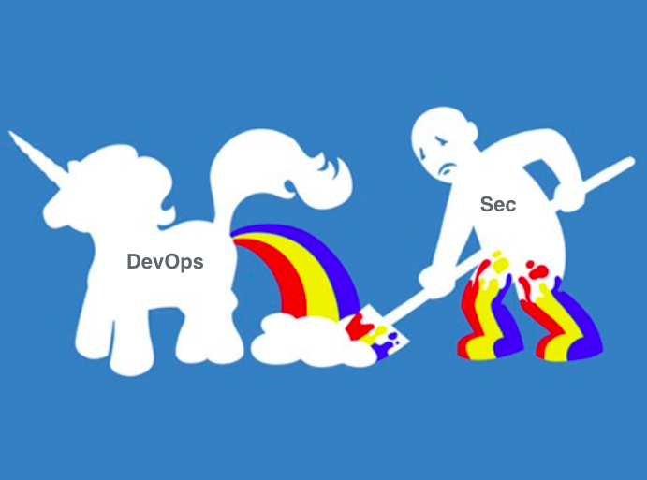
The Issues – Security – We live in a DevOps world
We live in a DevOps world
Changes that impacts on security posture happen CONTINUOUSLY
@petecheslock
Notes:
The issues – Security – We live in a DevOps world
Well if you think about it, if the goal is to control change but change is continuously happening in our organizations (in the actual world that we live in), where does that leave us?
Only one result – we will constantly miss important changes that impact the security posture of our organization and thereby fail in our roles
That looks like what is happening when we look at the news.. Organizations that have massive budgets like large social media companies and car manufacturers (without mentioning names) are getting breached in the public cloud. Why? In some cases, the DevOps teams are continually deploying into the public cloud environments (sometimes 10 or more deployments per day in production) and security are not even aware when security misconfigurations have happened talk less of being able to react to them.
As the quote on the screen highlights – humans are writing these codes that does these deployments and error is inevitable. They may be able to fall back quickly but what foothold has been gained in the time when the vulnerability was active.
This wonderful integration has happened between Dev and Ops to create this awesome unicorn but rather than security getting involved in this whole new world, we’ve been content to clean up on security messes afterward BUT THIS IS NOT GOOD ENOUGH in the modern world!
And in this modern world, where everything moves quickly at the speed of light. Software moves at a very high velocity, the environment that software runs in is deployed at a high velocity and the ATTACKS also moves at a high velocity and this is no exaggeration.

Slide 11
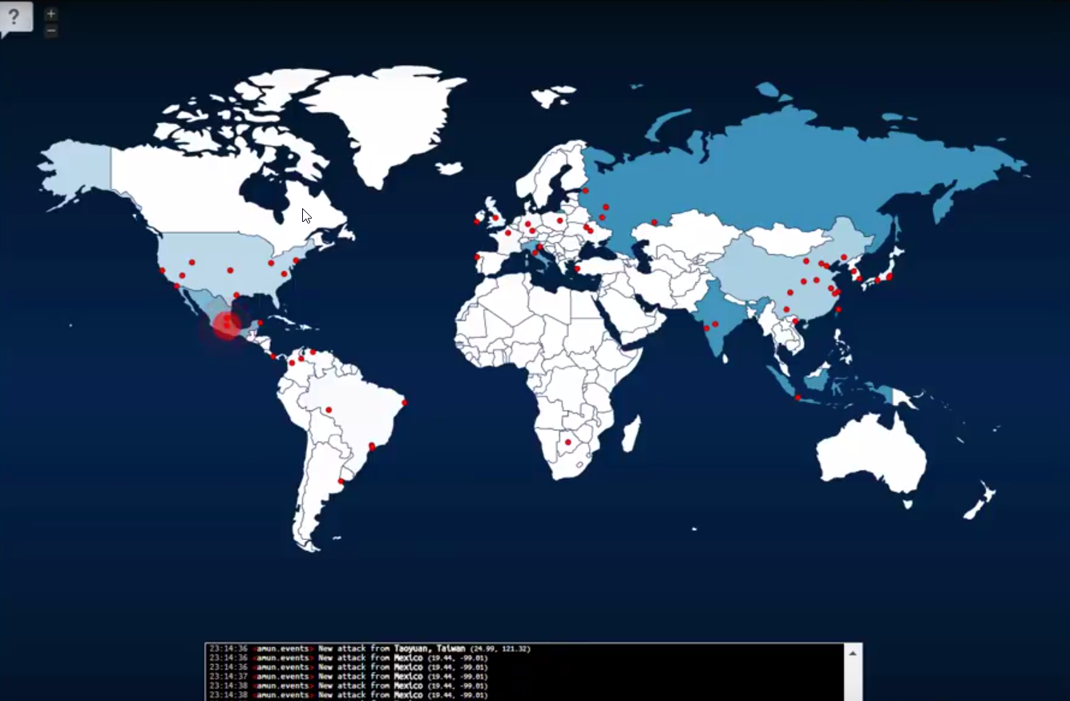
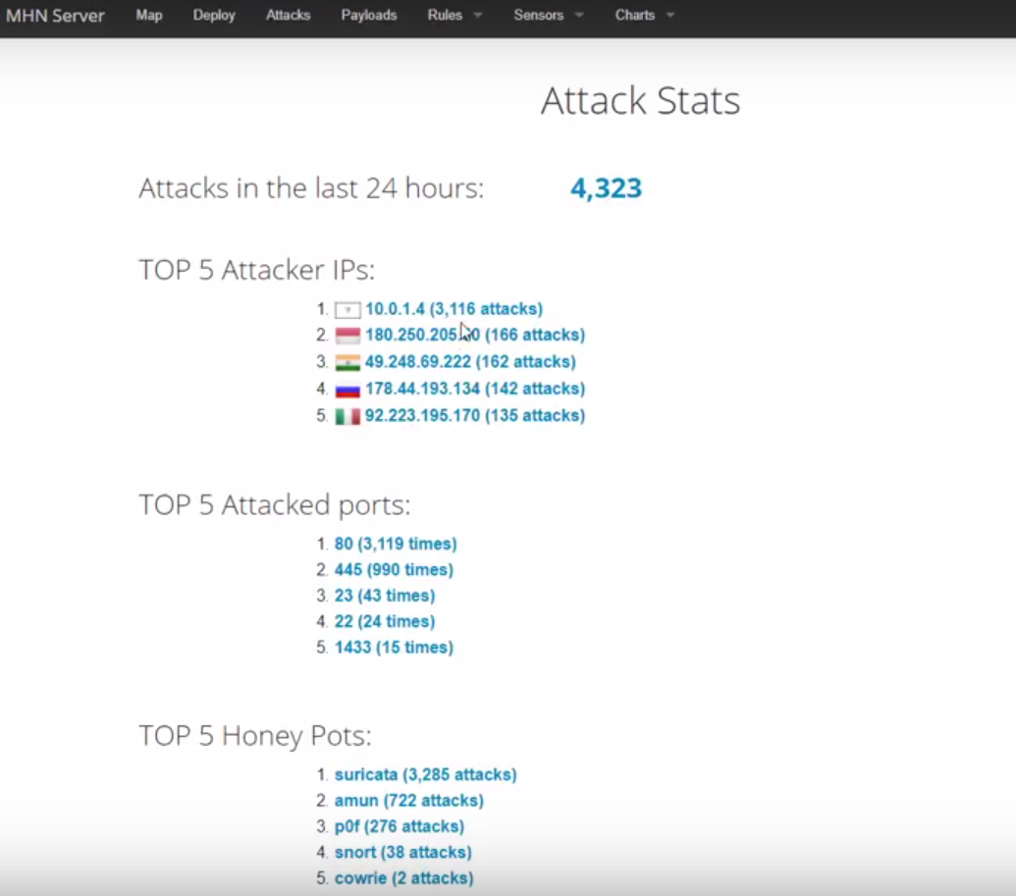
Cloud Threat Intelligence - https://youtu.be/6xnX42FXOsM
Notes:
I have a video up on YouTube where I deployed honeypots across multiple regions in Azure to see how quickly I get attacked and the types of attacks and literally in seconds I got hit with a bruteforce attack followed by different vulnerability scans and in literally a few minutes, I had clocked thousands of attacks!
We can’t afford to let DevOps just carrying on at a high velocity while we operate from the outside. We either have to slow them down OR we need to transform ourselves, dress up and join the party.
Attacks are automated and very quick
The use of AI and machine learning add complexity to this also

Slide 12
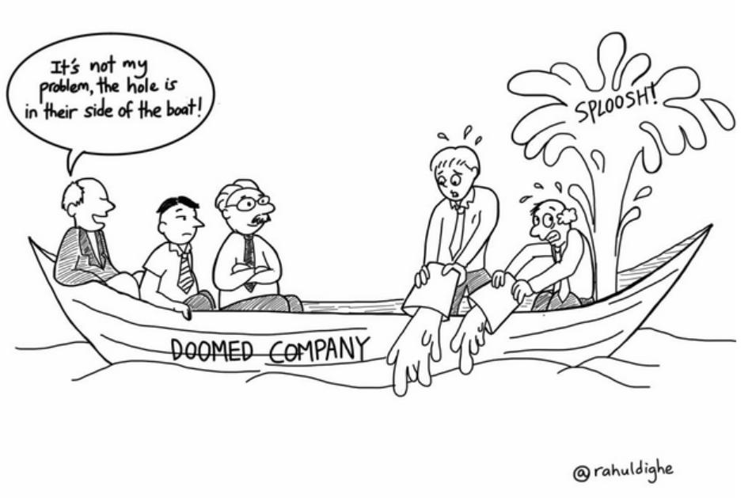
The Issues – Security – We’ve forgotten the ecosystem
Hackers will gain control through the weakest link
and slowly progress through the environment
Hacker dwell time increasing
Notes:
We’ve forgotten the ecosystem
The second issue that we have with the way security currently operates in organizations is that for far too long we’ve made security about technologies and point products.. Yeah we talk about defense in depth but we’ve again not translated this into a DevOps world…
We have to a big extent become very myopic in our focus rather than seeing the big picture
In truth security should be just an attribute of a system and software and not an after thought add-on
And one thing that security teams know very well is that hackers don’t care about the point of entry into our environment, they just want a point of entry! We’ve always known this but yet we’ve left a big part of our environment under risk by not getting involved with the DevOps culture shift.
And we need only look at the tactics hackers have been using in the past 5 years to see what I mean by this. Hackers treat our environments like an ecosystem!
They'll attack it at a weak point, then hop through the environment, switching methods on the fly and as necessary, evading capture and slowly eroding security measures until they get to exactly where they want to be.
An example of this is the infamous Equifax breach. Hacker bots were scanning the internet for vulnerable systems and they stumbled on a weak point in the Equifax environment. This started a month long reconnaissance within the environment, hiding in the Equifax network for more than four months before the security team stumbled on this. At that point, they already accessed the personal information of over 143 million people.
The security function cannot afford to get involved only at the end. We need to take a different approach and start seeing security as a system. Instead of deploying security as a product it's about examining the entire system, or ecosystem if you will, as security just be another property of a system - integrated and pervasive throughout.
It's the old saying of "A chain is as strong as its weakest link" applied to your entire estate, both on-premise and in the cloud, both sitting at a desk and on the road. Any weakness in any part of the ecosystem is a detriment to the ecosystem as a whole. Our adversaries are doing this, the school of though behind ecosystem security thinking asks "Why don't we?".
And to do this, we’ll need to get involved from the very beginning as bad security decisions are made from the very start of ideation, all the way through the software development, testing and operations processes!
Potential security flaws can exist anywhere from the source code, code that you write, or code that you borrowed - OSS - Open Source Code (this is big as there was a time we thought that many eyes helps to make open source code more secure.. similar to why organizations adopt peer coding… but in some cases, there have been deliberate vulnerabilities written into OSS)
What we've done so far which for many organizations is just educating developers and then stopping there is not enough. For an in-house software development team, it's a challenge to review all the source code for every software release. This is not only because of the pressure of release cycles, but because of the impracticality of requiring every developer to be familiar with all the secure coding best practices for all different programming languages, such as Java, C/C++, and Python.

Slide 13
The Issues –
DevOps
Notes:
The issues with where we are

Slide 14
The Issues – DevOps – Lacks Security Emphasis
DevOps has not emphasized security enough
In speeding delivery time, sometimes vital aspects are skipped

Slide 15
What is this
DevSecOps
you speak of?
Notes:
I was at the AWS Re-Invent conference last year and there was a session titled
Called by many terms – SecDevOps; DevOpsSec; Rugged-IT
Automation and Security in the cloud world
We’ve sped up our process for creating environments and delivering applications but Security needs to match this pace also
We cannot seriously address security in the modern world without taking an automated approach..
DevOps people are typically not security experts. Nothing wrong. It’s not just the skillset of many nor should it be except they want to
D
4 Principles of DevSecOps in the Cloud (according to LogicWorks)
Design for constant change
We’re constantly going to
Build repeatable components
We’re not dealing with every issue as if it’s the first time we encountered it.
Anticipate failure
Everything as code
D
Issues that we have
Modern applications are largely “assembled”
Cloud adoption and continuous dev cycles often circumvent traditional security process and checks
Security collaboration – Bring individuals of all abilities to a high level of proficiency in security in a short period
D
We must be able to evangelize and communicate what is going on in our organizations and market it
D
D
De
D

Slide 16
DevSecOps Is the extension of the DevOps culture for the inclusion of Security

Slide 17
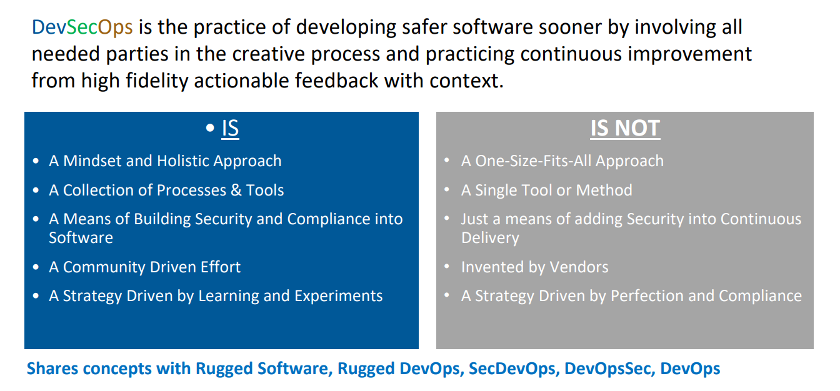
DevSecOps

Slide 18
DevSecOps
Components

Slide 19
DevSecOps Components
#1 – Focus on automation
#2 – Focus on shifting left
#3 – Focus on education and empowerment

Slide 20
DevSecOps Component #1 – Focus on Automation
Time matters in a continuous delivery world
Notes:
Focus on automation
Why? Because time matters in a devops, continuous delivery world
We can’t integrate and enter this world with our manual scanning, reports and processes

Slide 21
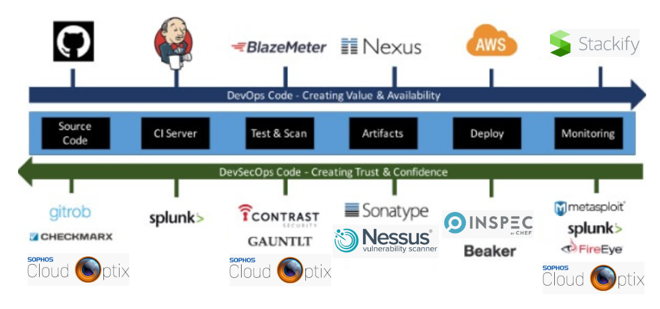
DevSecOps Component #2 – Focus on Shifting Left
Seeing security not as an outside activity but as an attribute of your application
Notes:
Shifting left…
Security in DevSecOps moves it’s activities to earlier stages of the Software Delivery lifecycle
Security gets involved from the ideation to production and all the way back..
But of course there will be challenges..
For example, security will need to learn we need to learn Dev and Ops tools and terminologies… like source control, git, ci server, Jenkins, CICD
Security will need to learn new security tools that integrates well with the CICD pipeline…
The goal of this will be to educate and empower Dev and Ops to see security not as an outside activity but as an attribute of the application that they are managing and operating
I can’t emphasize this enough. We must integrate with the existing toolsets and orchestration workflows that DevOps teams use!
An example of that is the Sophos Cloud Optix solution integrating with Jenkins and the CICD pipeline..
How many of you use Jenkins?

Slide 22
DevSecOps Component #3 – Focus on Empowerment
10:1
Dev:Ops

Slide 23
DevSecOps Component #3 – Focus on Empowerment
100:10:1
Dev:Ops:Sec
Notes:
So devsecops is about the security professionals in your organization engaging with you at a very early stage… similar to what the devops culture has achieved with the collaboration between development and operations
The truth is that this wont be easy.. for most organizations, for every 100 development professionals, there are 10 ops professionals and 1 security professional
So DevSecOps cannot be about security doing all the work. That won’t be scalable across an organization.. Instead the focus of security needs to change!
In DevSecOps, security focuses on education and empowerment and not gating.. similar to what DevOps achieved with operations
The goal will not be to make Dev and Ops security experts! The goal will instead be to know enough to be able to make the right decisions with Security acting as trusted advisors and auditors
Security team dont take on the role of testers but auditors and enablers
Giving more ownership rather than just automation

Slide 24
Key Takeways
The New Security Playbook
Empathy and Enablement
Be Fast and Non-Blocking
Security testing automated in every phase
Security provides value through making security normal
Security’s Path to Influence
Influence organizational culture
Automate and Monitor across the pipeline
Identify resource misconfiguration

Slide 25
Sample

Slide 26
Resources
Agile Application Security book (O’Reilly)
Building a Modern Security Program book by Rebecca Huehls and Zane Lackey
Hands-On Security in DevOps book by Tony Hsu
DevSecOps: Building a Secure Continuous Delivery Pipeline
Linux Academy – DevSecOps Essentials
WebSites
https://www.devseccon.com (DevSecCon)
https://www.devsecops.org/

